Slide 1
Azure Automation

Slide 2
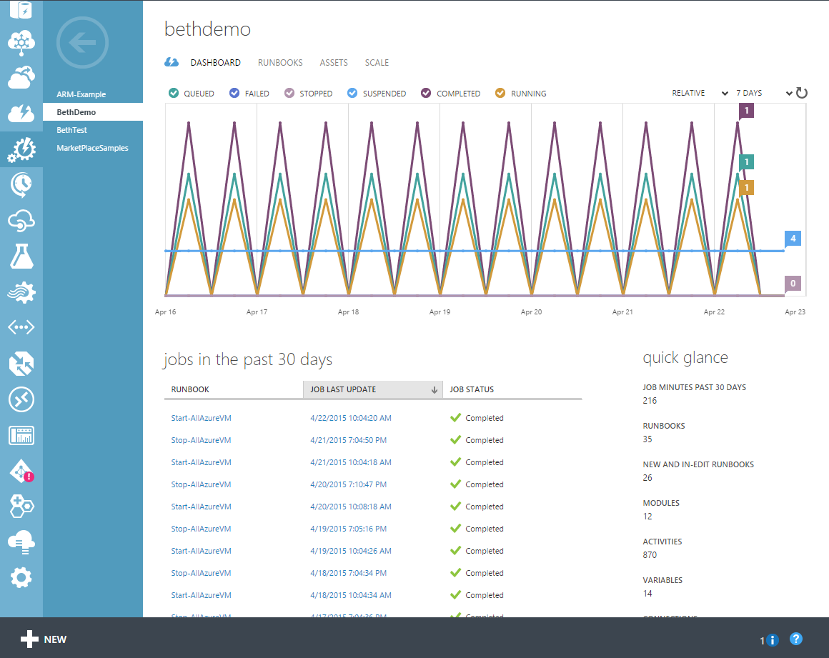
Automation in the portal
Features
PowerShell runbook editor
Test & publish runbooks
Monitor & troubleshoot production jobs
Runbook Gallery
Resources
Runbooks
Jobs
Modules
Schedules
Certificates, variables, credentials, connections

Slide 3
Automation Concepts
Core Automation resources
Runbooks: textual and graphical
Runbook Jobs
Automation resources used by runbooks
Runbook triggers: schedules, and webhooks
Modules, Certificates, Connections, Variables, Credentials
DSC Configurations (coming soon to the portal!)
Hybrid Runbook Workers

Slide 4
Demo
Workflow Editoren
Mit Service-Konto aus Azure Active Directory

Slide 5
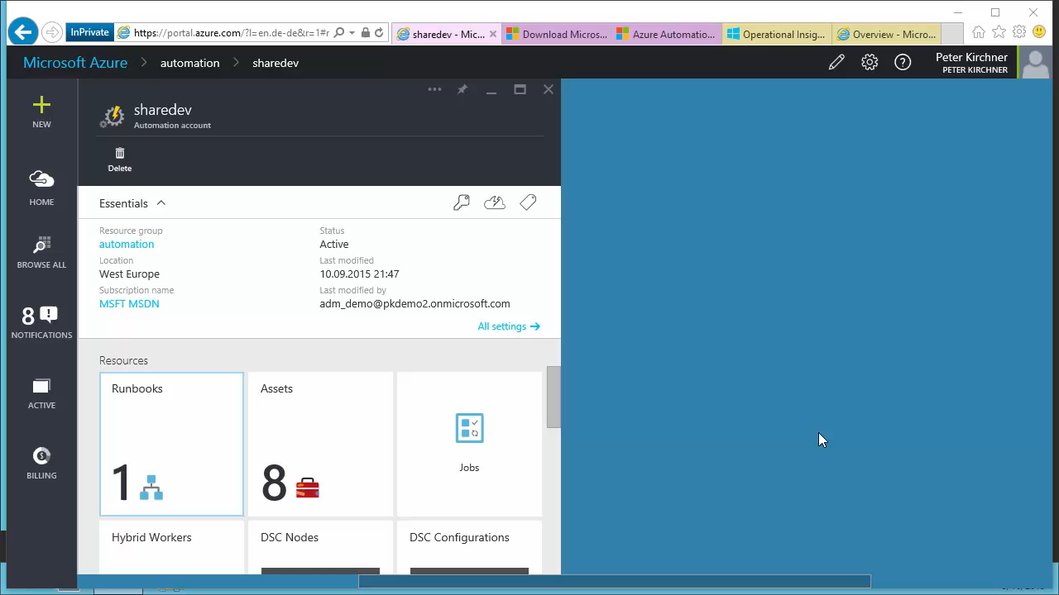

Slide 6
Extending Automation with Integration Modules
Integrate into 3rd party systems
Extend Automation like you would PowerShell
Import PowerShell modules that function against other systems
Hundreds of 1st + 3rd party PowerShell modules exist today
Automation Integration Module = PowerShell Module + one extra optional file
Some constraints on PowerShell modules that can be imported into Automation
Must not have any dependencies outside of the module folder
Write your own modules
Write Automation modules for custom solutions
Simply write PowerShell modules in C# or PowerShell
Can integrate anything with a REST API!
Some best practices to make your modules light up in Automation

Slide 7



Integrate on-prem and cloud
Source Control
ARM Template
Site Content
Azure
Website
Azure Automation
On-premises data center
Hybrid runbook worker
On-premises VM

Slide 8
Automation Hybrid Runbook Workers
What is hybrid?
Hybrid Runbook Workers in Automation allow you to run runbooks on machines located in your data center in order to manage local resources
Runbooks are stored and managed in Azure Automation and delivered to one or more on-premises machines where they are run
Why use hybrid?
Allows for management of on-premises resources from Azure Automation
Provides single location for handling automation tasks across clouds and data centers
Removes the need to deploy, maintain and upgrade an Azure Pack / SMA environment
How do you use hybrid?
Start a runbook using Automation cmdlets and specify the hybrid worker for the runbook:
Start-AzureAutomationRunbook -Name <rb> -AutomationAccountName <acct> -RunOn <GroupName>

Slide 9
Demo
Hybrid Worker einrichten

Slide 10
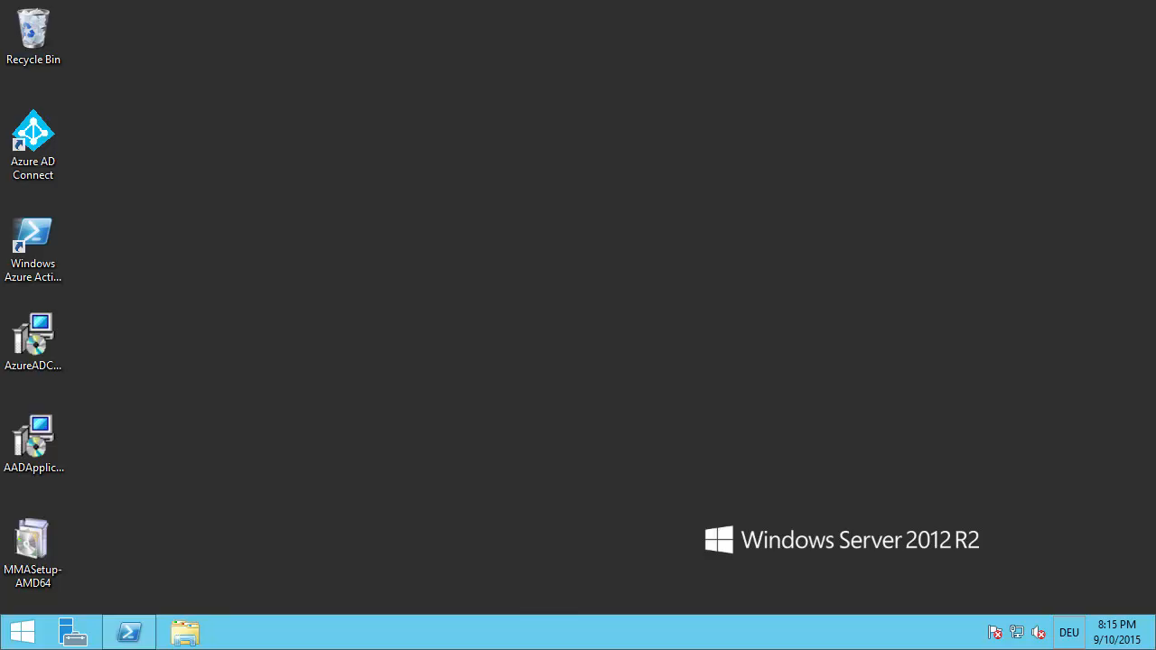

Slide 11
Demo
Hybrid Worker nutzen

Slide 12


Slide 13

© 2013 Microsoft Corporation. All rights reserved. Microsoft, Windows, and other product names are or may be registered trademarks and/or trademarks in the U.S. and/or other countries.
The information herein is for informational purposes only and represents the current view of Microsoft Corporation as of the date of this presentation. Because Microsoft must respond to changing market conditions, it should not be interpreted to be a commitment on the part of Microsoft, and Microsoft cannot guarantee the accuracy of any information provided after the date of this presentation. MICROSOFT MAKES NO WARRANTIES, EXPRESS, IMPLIED OR STATUTORY, AS TO THE INFORMATION IN THIS PRESENTATION.

